Slide 1
First Sponsor Demo
Norbert Szücs
Pallida Cohort - Static Class

Slide 2
C++ Virtual Functions Basics
Member function in base class
Inheritable and overridable method
Expected to redefine in derived classes
Notes:
A virtual function is a member function that you expect to be redefined in derived classes. When you refer to a derived class object using a pointer or a reference to the base class, you can call a virtual function for that object and execute the derived class's version of the function.

Slide 3
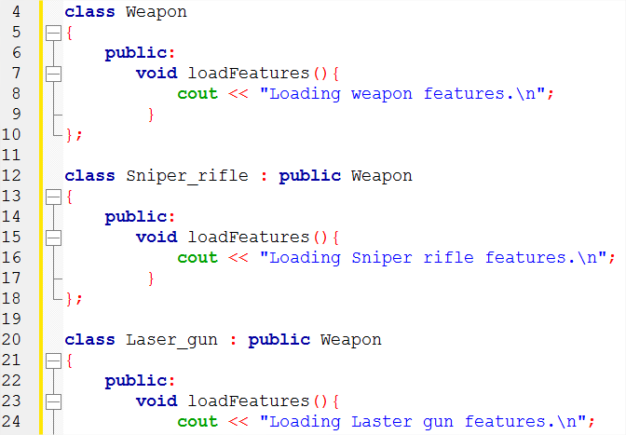
C++ Virtual Functions Program w/o virtual function
Notes:
Let’s say we want to create a game where we will use weapons.
First we need Weapon class and derived two classes as Sniper rifle and Laser gun to load features of each weapons.

Slide 4
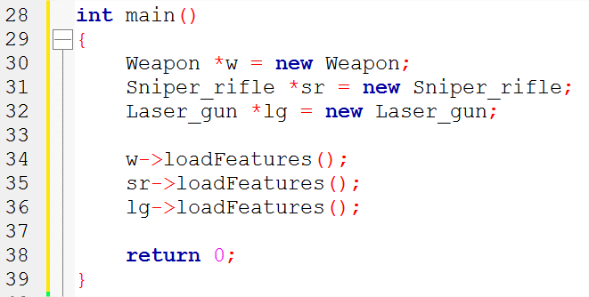
C++ Virtual Functions Program w/o virtual function
Notes:
Then in the main we define 3 pointer objects, „w”, „sr” and „lg” of classes Weapon, Bomb and Gun and call loadFeatures member function of each objects

Slide 5
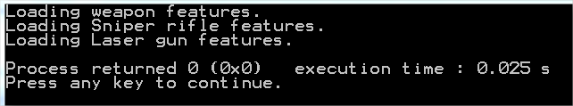
C++ Virtual Functions Program w/o virtual function
Notes:
Works as we expected. But what is the case if our project is getting bigger and bigger and we need other features? The easiest way to create a separate Loader class to load these features.

Slide 6
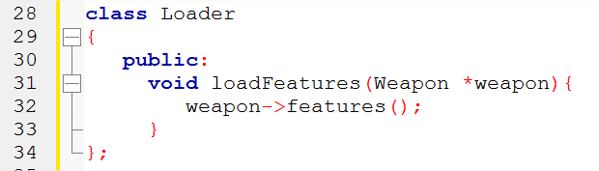
C++ Virtual Functions Program w/o virtual function
Notes:
loadFeatures method loads the feature of a specific weapon. Let’s see what happens.

Slide 7
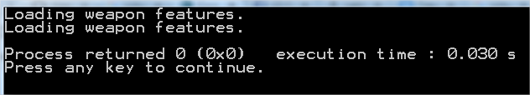
C++ Virtual Functions Program w/o virtual function
Notes:
It doesn’t really look good, both the Laser gun and the Sniper rifled inherited the feature of weapon.
What’s wrong?
The reason is that the loadFeatures method of the Loader class takes pointer to object of a Weapon class as an argument.
To solve this, we need to make the base class function, Weapon class virtual.

Slide 8
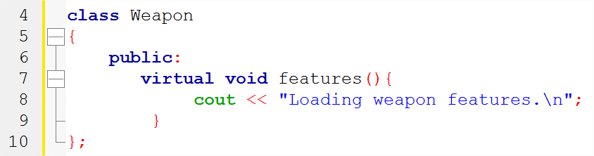
C++ Virtual Functions Program w/ virtual function
Notes:
To solve this, we need to make the base class function, Weapon class virtual by putting virtual keyword before the features method.

Slide 9
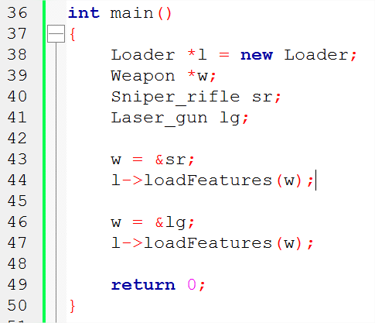
C++ Virtual Functions Program w/ virtual function
Notes:
Also, we need to make some adjustment in the main function aswell.
„L”->loadFeatures function calls the function of the different classes which depends on where „L” object is pointing.

Slide 10
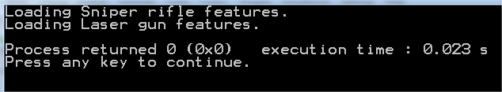
C++ Virtual Functions Program w/ virtual function
Notes:
It works as intended and as we wanted. So, using virtual method made our code not just clearer but flexible and easier to understand. Also, it will be easy to add another weapon to our armory for example.
So, as a message, Keep in mind how useful is to work with virtual methods. It can make your life much much easier.

Slide 11
Thank you for your attention!

